Slide 1



Spatial Computing and Social Media in the Context of Disaster Management

Slide 2
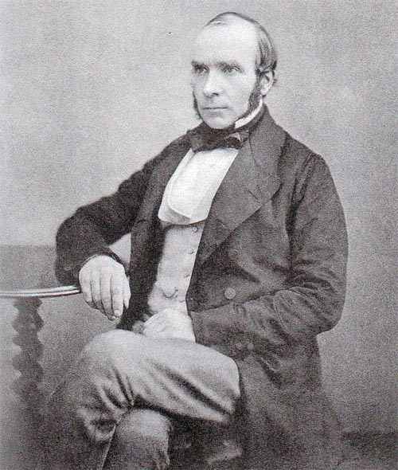
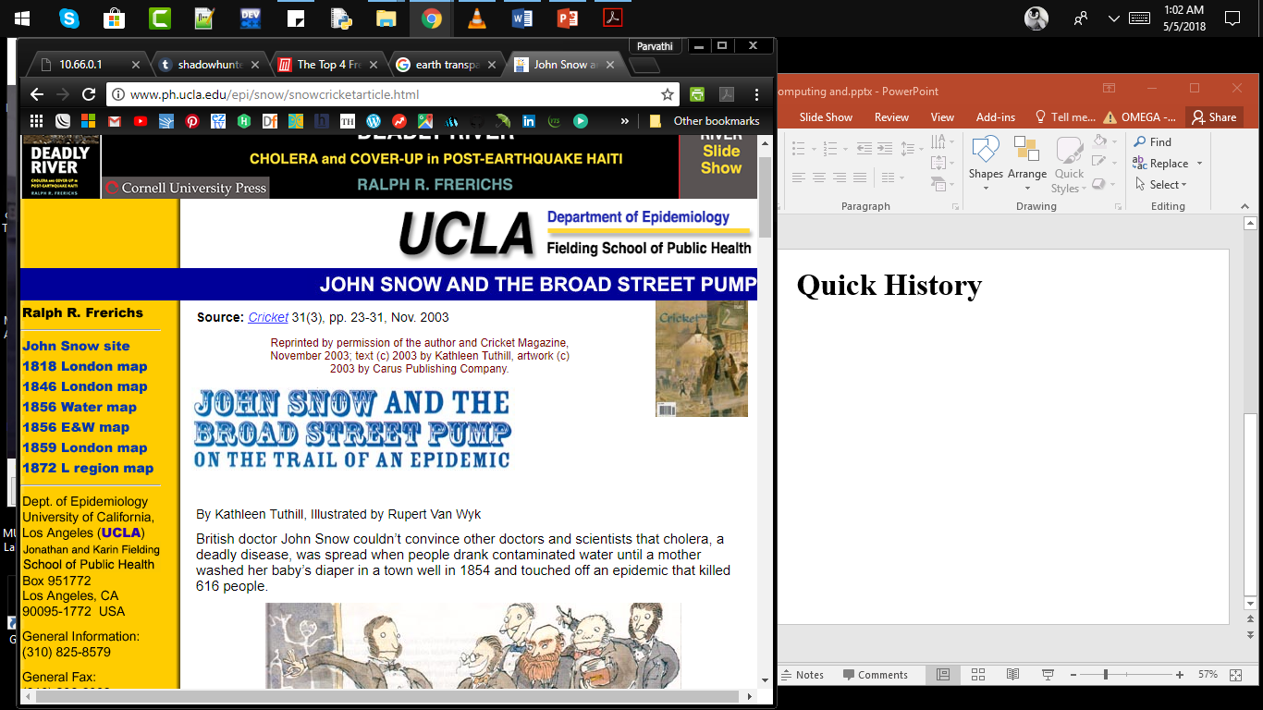
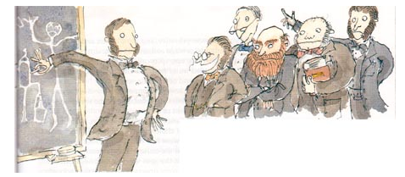
Notes:
British doctor John Snow couldn’t convince other doctors and scientists that cholera, a deadly disease, was spread when people drank contaminated water until a mother washed her baby’s diaper in a town well in 1854 and touched off an epidemic that killed 616 people.

Slide 3
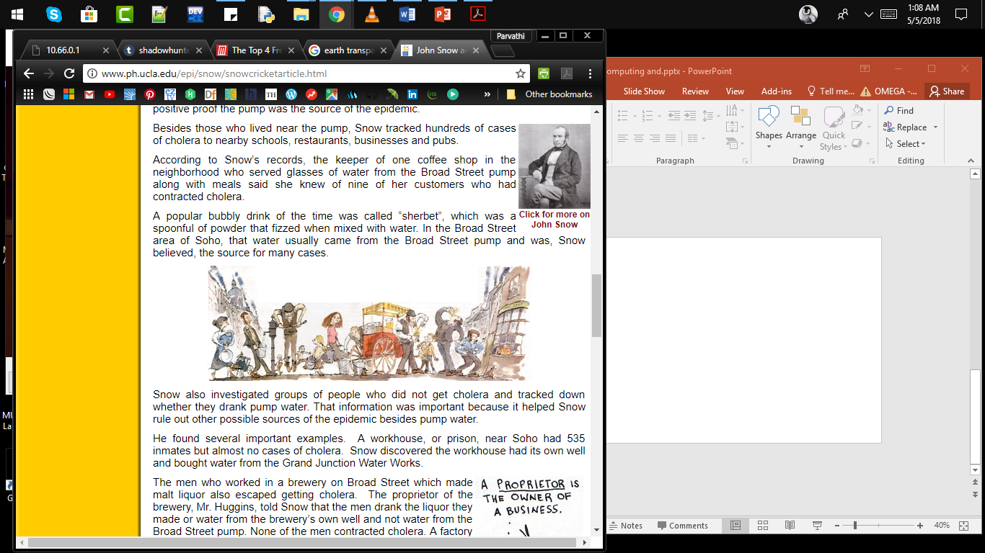
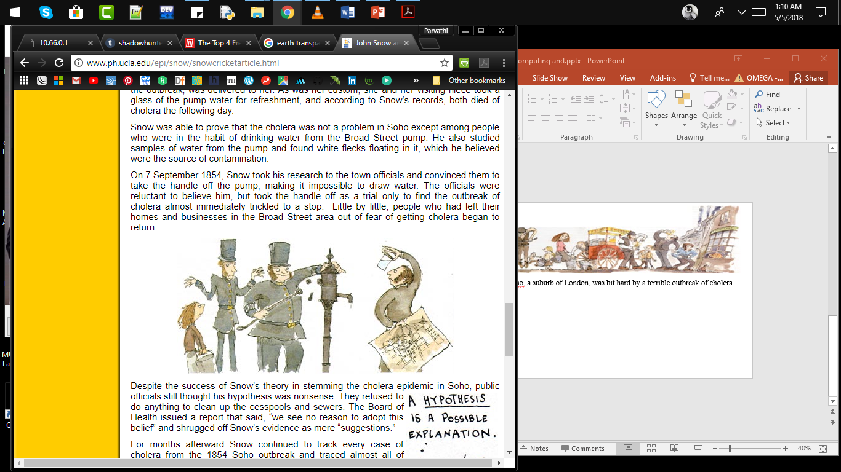
In August of 1854 Soho, a suburb of London, was hit hard by a terrible outbreak of cholera.
On 7 September 1854, Snow took his research to the town officials and convinced them to take the handle off the pump.

Slide 4


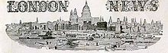
Reverend Henry Whitehead, took on the task of proving Snow wrong.
He interviewed a woman, who lived at 40 Broad Street, whose child who had contracted cholera from some other source.
A year later a magazine called The Builder published his findings along with a challenge to Soho officials to close the cesspool and repair the sewers.

Slide 5
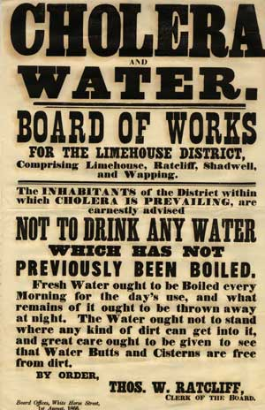
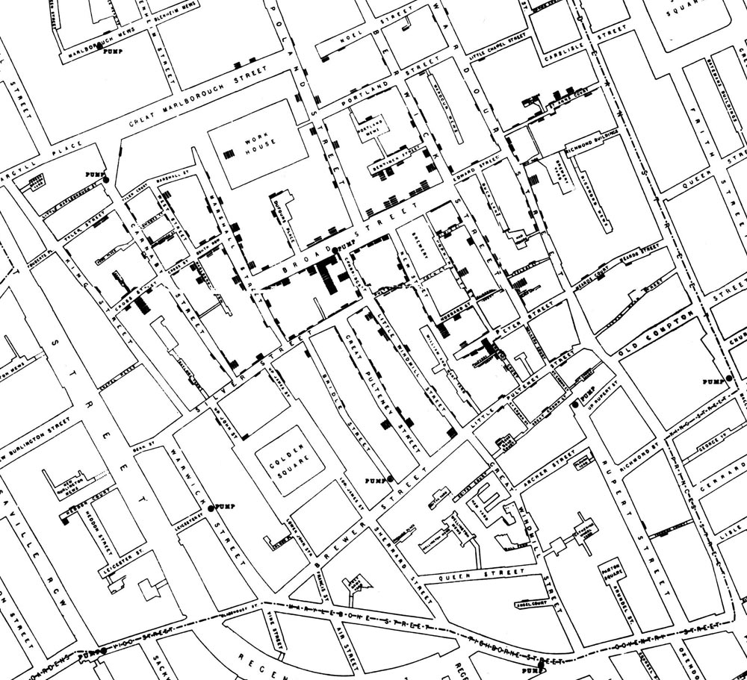
“It is not difficult to make maps, but it is difficult to collect data.”

Slide 6

Why is location data not being collected?
Answers by many Health Professionals was,
Not my job
Don’t have the time
Don’t have the skills/equipment
Didn’t think about it at the time

Slide 7
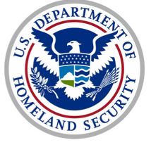
PROPOSED WORK
Enable effective and timely information sharing for situational awareness and informed decision making.
Social Media Alert and Response to Threats to Citizens (SMART-C)
Establish a bidirectional link between emergency response authorities and citizens
SMART-C would send “customized” alerts to citizens based on their location and temporal attributes

Slide 8
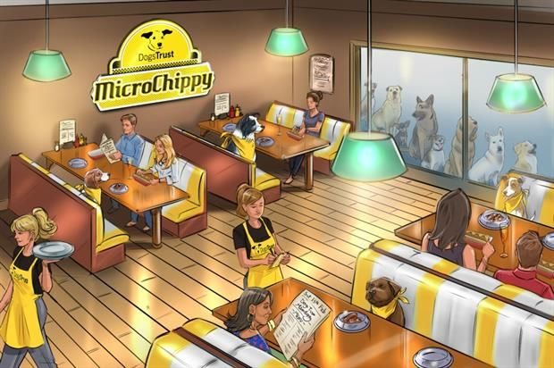

Multiple residents post tweets about getting sick after eating at local restaurants in a given region different restaurants and report
different symptoms (fever, stomach ache, and so on).
SMART-C would send alerts that those who might have visited such restaurants within a specific time period should seek medical help if they develop related symptoms

Slide 9
CHALLENGES
Privacy
Data Privacy
Context
Data Perturbation

Slide 10
Location and Temporal Privacy rely on Anonymization.
Anonymization
Perturbation
Path Cloaking
Mixing Identifiers

Slide 11
A Kind Note:
“Opportunistic data collection is simple. Just remember to do this when you visit any location, take a picture of anything you find interesting and upload it. Its very simple and effective and this would turn every single one of us into a data collector without having lots of training without needing expensive technology. This is probably the only way we’re realistically going to be able to map a major breakout at the time we need to.”
- Chris Grundy
(Lecturer in Geographical Information Systems)
London School of Hygiene

Slide 12
REFERENCES
http://www.ph.ucla.edu/epi/snow/snowcricketarticle.html
ttps://www.youtube.com/watch?v=USZtsvEnP1A
https://ieeexplore.ieee.org/stamp/stamp.jsp?tp=&arnumber=6365203

Slide 13
THANK YOU

